Slide 1

OMDENA – LA Local Chapter
LA Open Datasets

Slide 2

Payroll : 2013 - 2022
Shape : (685461, 18)
https://github.com/OmdenaAI/la-usa-chapter-open-data/blob/main/src/visualizations/payroll_analysis.ipynb

Slide 3
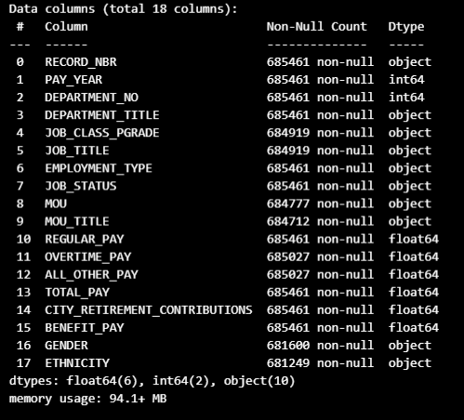
Memory usage: 94.1+ MB
D Types: float64(6), int64(2), object(10)
Data columns (total 18 columns)

Slide 4
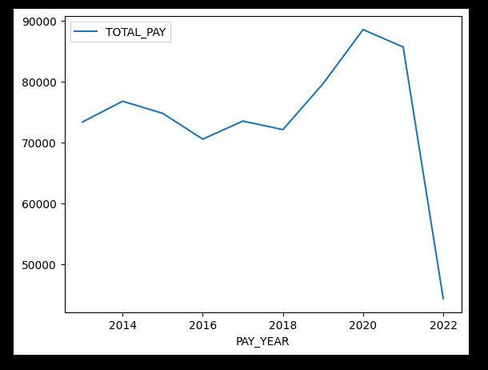
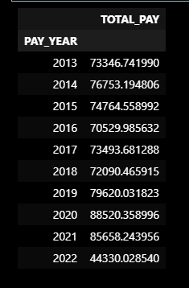
Average of the paid amount by year
Average salaries started to fall in 2021 and dropped significantly in 2022.

Slide 5
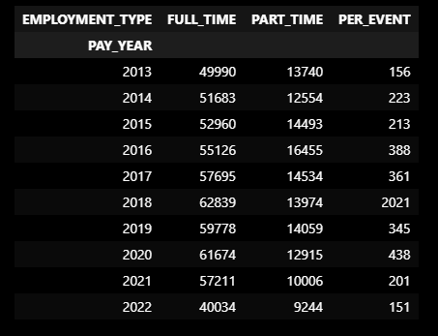
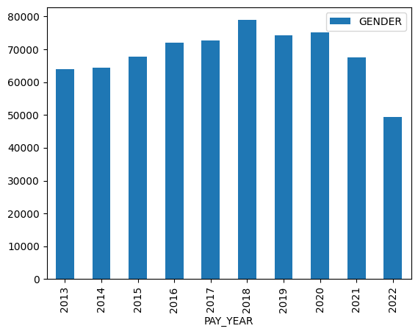
Total Employees
The number of employees will decline in 2021, especially in 2022

Slide 6
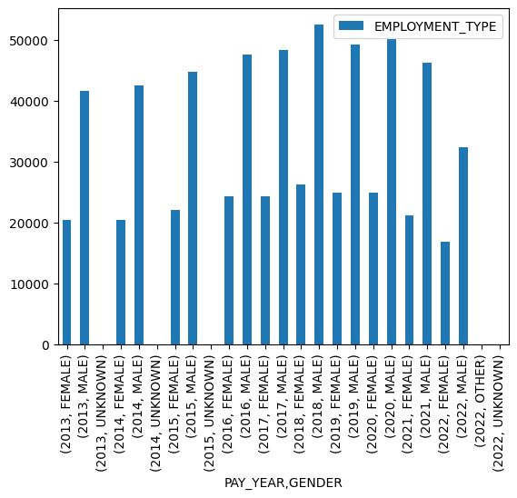
Total Employees by the different gender and years
For the period from 2013 to 2022, there are more male employees than there are female employees.

Slide 7
OMDENA – LA Local Chapter
LA - Payroll
We deduced from the statistics that fewer employees meant lower average pay, which started to decline in 2021.
As there will be fewer staff starting in 2021, we must ascertain why this is happening and whether Covid-19 is involved.

Slide 8
Thank You

